Slide 1
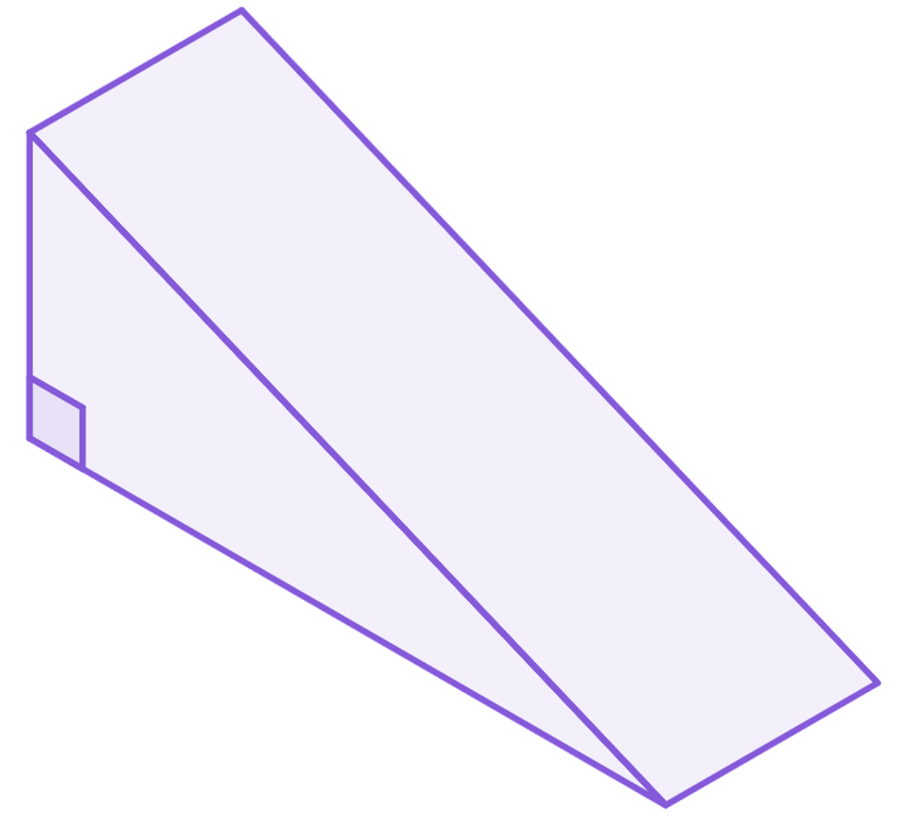

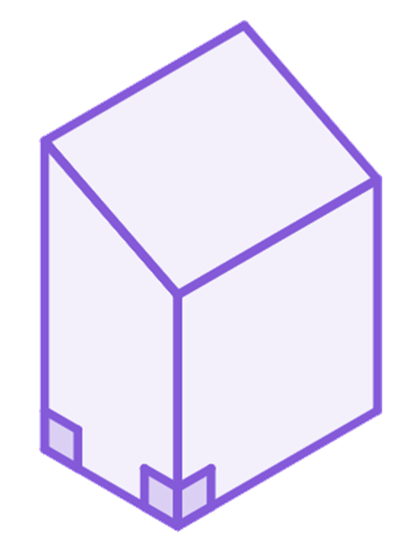
Problem solving with perimeter, area and volume
Task A: Surface area and volume
1) The surface area of this triangular prism is 240 cm².
a) What is the length of the prism?
b) Hence calculate the volume of the prism.
5 cm
13 cm
2( × 5 × 12) + 12l + 5l + 13l = 240
60 + 30l = 240
12 cm
30l = 180
l cm
l = 6
Volume = ( × 5 × 12) × 6 = 180 cm³
2) The volume of a cylinder is 324𝜋 cm³ and its height is 9 cm.
Work out the cylinder’s surface area.
Volume = 324𝜋
Surface area = 2𝜋r² + 2𝜋rh
𝜋r² × 9 = 324𝜋
Surface area = 2 × 36𝜋 + 2𝜋 × 6 × 9
𝜋r² = 36𝜋
Surface area = 72𝜋 + 108𝜋
r² = 36
Surface area = 180𝜋 cm²
r = 6
5 cm
3) The surface area of this prism is 516 cm².
Work out the volume of the prism.
Surface area = 516
20 cm
17
cm
2( × (20 + 17) × 4) + 20l + 4l + 17l + 5l = 516
148 + 46l = 516
l cm
46l = 368
4 cm
Volume = ( × (20 + 17) × 4) × 8
l = 8
Volume = 592 cm³

Slide 2

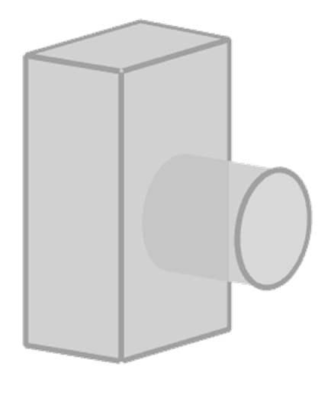
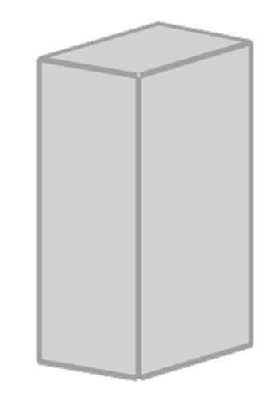
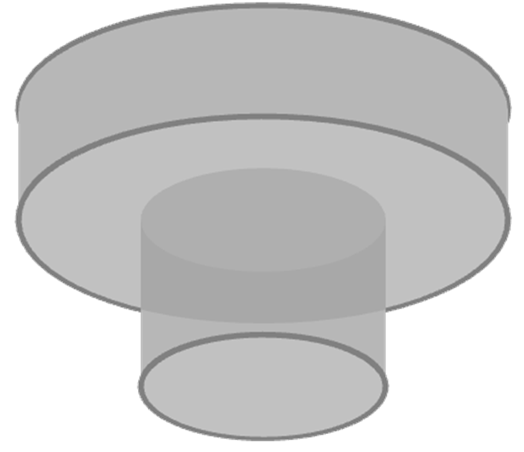

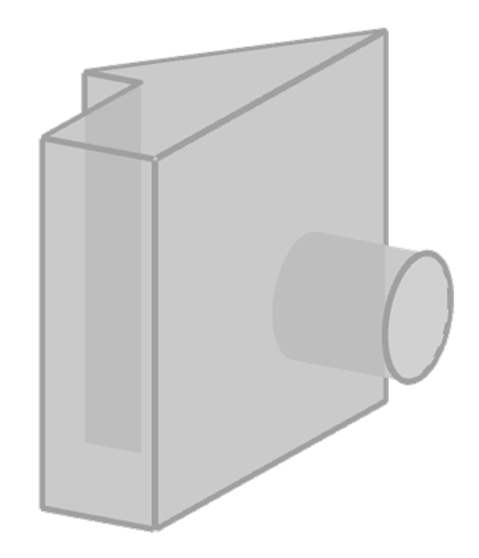
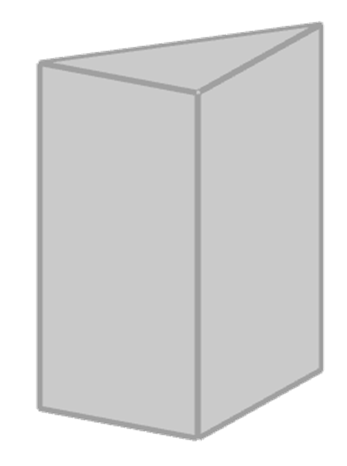
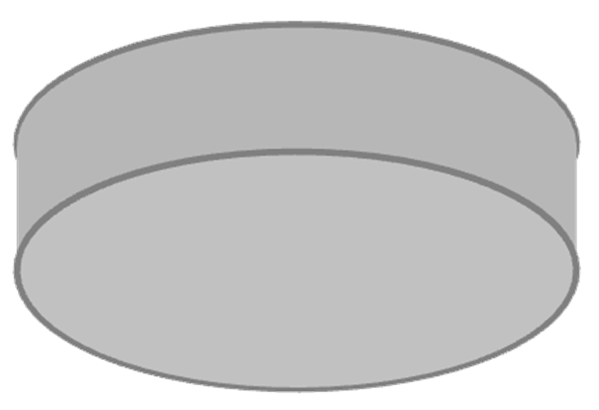
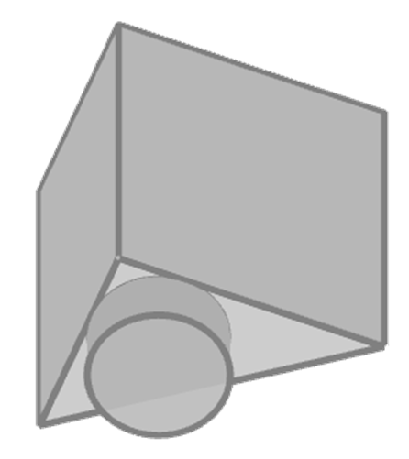
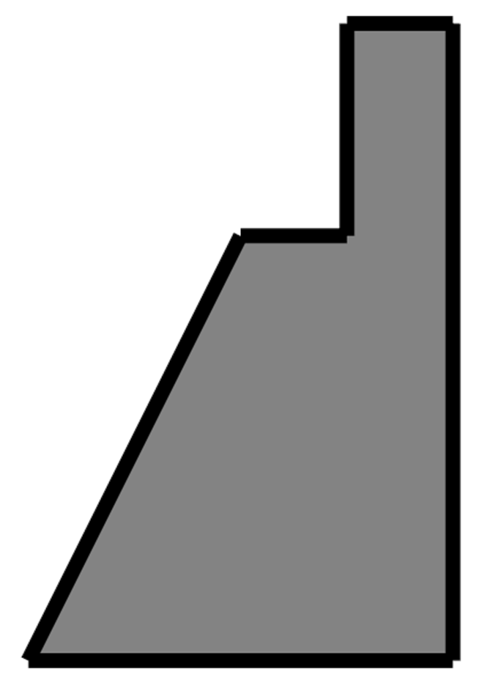
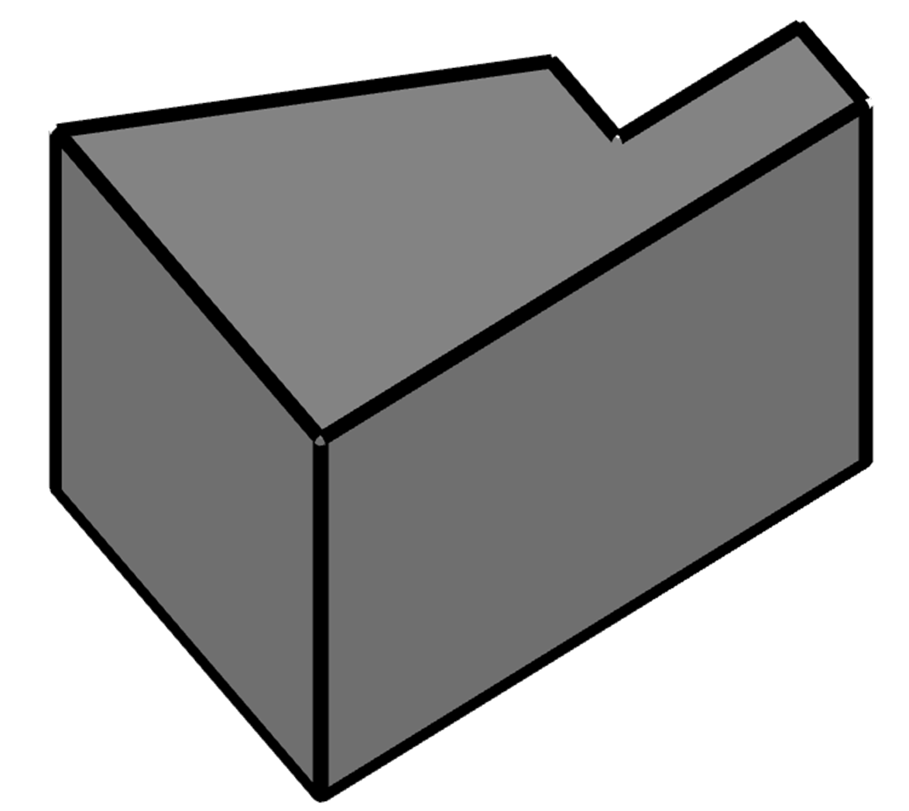
Problem solving with perimeter, area and volume
4) The areas of three faces have been given. The edges are integer amounts of centimetres. What is the volume of this cuboid?
60 cm²
Volume = 12 × 5 × 9 = 540 cm³
108 cm²
45
cm²
9 cm
12 cm
5 cm
Task B: Composite solids
1) Match the composite solid with its parts.
2) Calculate the volume of this prism.
Area of A
= 8 × 16
= 128 mm²
A
25 mm
16 mm
8 mm
8 mm
B
Area of B
= × (23 + 16) × 24
= 468 mm²
22 mm
Area of cross-section
= 128 + 468 = 596 mm²
23 mm
40 mm
Volume
= 596 × 22 = 13 112 mm³

Slide 3
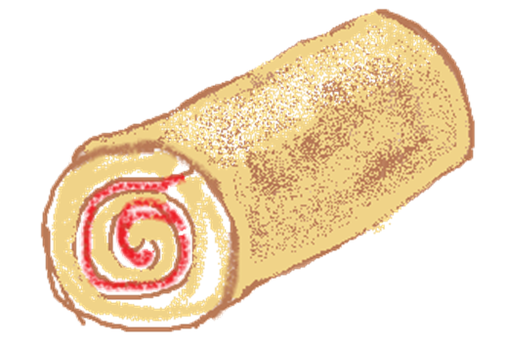
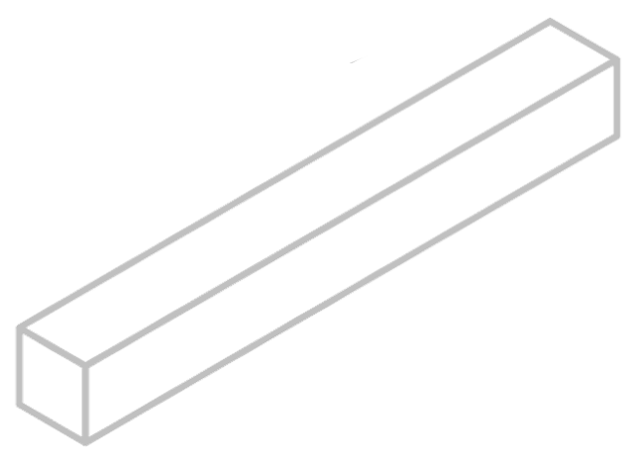
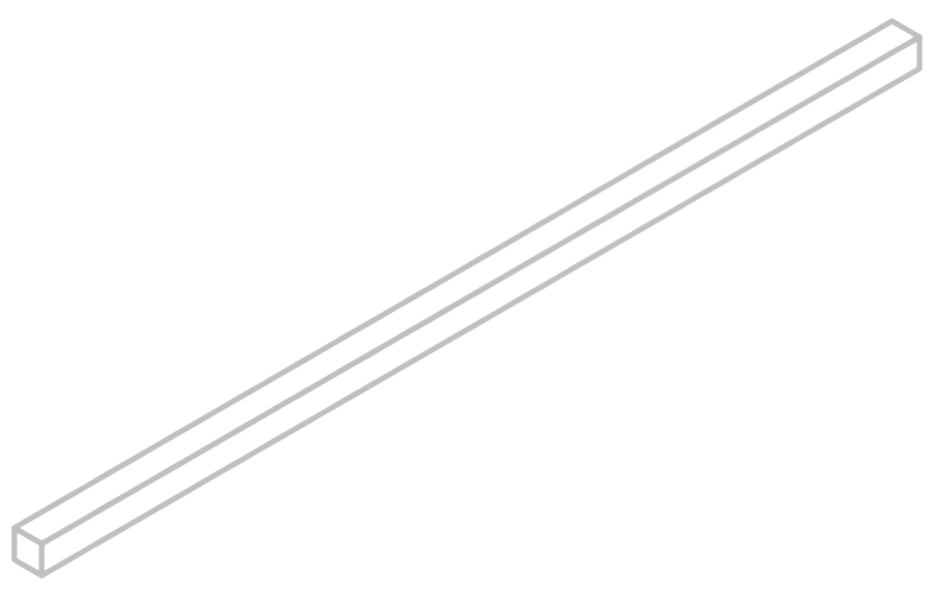
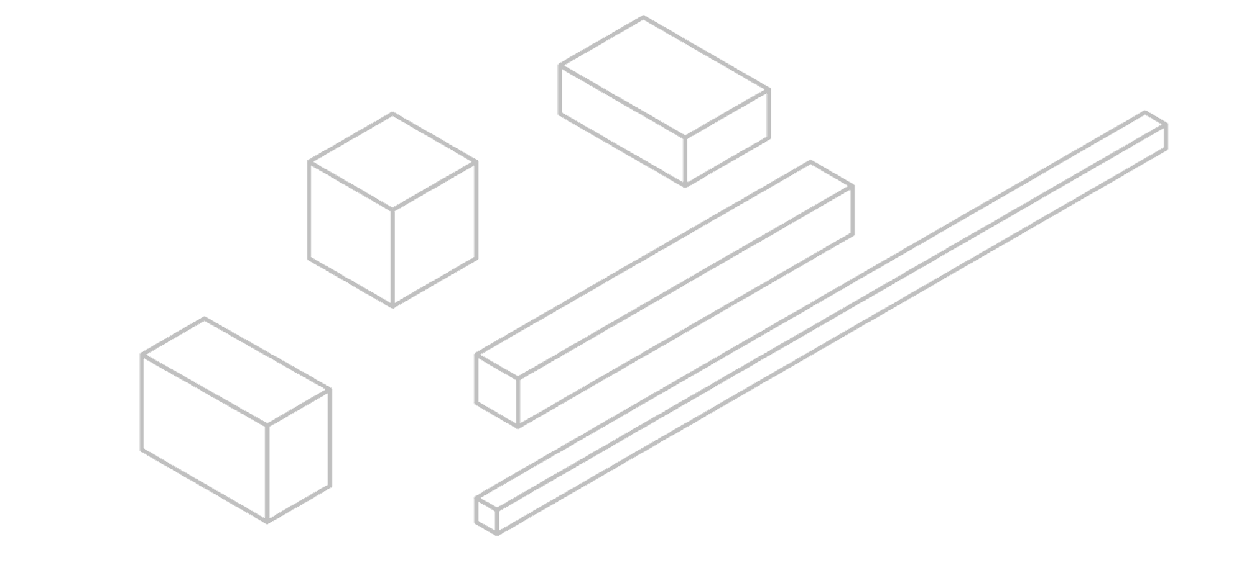
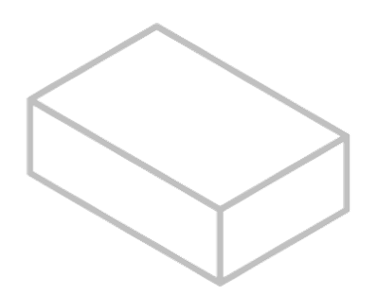
Problem solving with perimeter, area and volume
Task C: Problems in context
1) A baker makes 24 mini swiss rolls and wants to cover them in chocolate. How many square centimetres of chocolate will the baker have used?
Surface area = 2 × 𝜋 × 1.5² + 𝜋 × 3 × 8 = 28.5𝜋 cm²
8 cm
Chocolate used = 24 × 28.5𝜋 =684𝜋 cm²
3 cm
2) A metal pole is melted down and remoulded into cubes with edges of 5 cm. How many cubes can be made from this pole?
7 cm
Volume of pole = 𝜋 × 7² × 45 = 2205𝜋 cm³
45 cm
Volume of cube = 5 × 5 × 5 = 125 cm³
Amount of cubes = 2205𝜋 ÷ 125 = 55.417…
55 cubes can be made
3) One factor that affects the rate of dissolving is the contact between the solute and the solvent.
Here are some sugar lumps (solute) of the same mass. When put in water (solvent),
which would have:
a) the most contact?
b) the least contact?
 | l | w | h
A | 40 | 5 | 5
B | 20 | 10 | 5
C | 10 | 10 | 10
D | 250 | 2 | 2
E | 12.5 | 8 | 10
D - 2008 mm²
C - 600 mm²
A
C
B
E
l = length (mm)
w = width (mm)
h = height (mm)
D
Mathematics in Education and Industry.
v2.2

